Slide 1

Data Structures and Analysis (COMP 410)
David Stotts
Computer Science Department
UNC Chapel Hill

Slide 2
Hashing, Hash Table,
HashMap

Slide 3
Hashing
A means of organizing data that
allows us to do a subset of the BST operations in ∼O(1) time !!
insert, delete, find
ordering operations ( findMin, traversals ) can’t be done

Slide 4
Hash Terms
Hashing is the basic concept of computing an integer (the “hash” or “hash value” ) from some data value (the “key” )
We intend to use that hash integer as an index into an array or table of associated data
Hash Table is the array where data is stored
HashMap is a MAP ADT implemented via hashing or hash table

Slide 5
Hash Function
Hash Function is the computation that generates a hash value from a key
hash ( key ) → int
Used to implement MAP via a hash table
get ( key ) from the MAP ADT
is (generally)
table [ hash(key) ] in the implementation

Slide 6
Hash Table
0
1
Hash Table is an array of the associated data values
Want to MAP
key “jones” to data “4824173”
Hash function takes STRING and produce INT
So if hash(“jones”) is 5
we have stored this association
(“jones”, 4824173)
By putting the data pair into array cell 5
2
3
4
5
jones, 4824173
6
7
8
9
10

Slide 7
Hash Table
0
smith, 6713490
1
allen, 5610072
We really want something like this
MAP (“jones”) is 4824173
We have to get it this way
table[ hash(“jones”) ] is 4824173
table[ 5 ] is ( jones, 4824173 )
For this hash function …
What is hash(“knox”)?
What is hash(“miller”) ?
2
miller, 8225193
3
trane, 3770216
4
5
jones, 4824173
6
gordon, 1377216
7
8
8
knox, 9937010
2
9
barnes, 2165561
10

Slide 8
Another Example
0
1
We often show the hash table with just the key stored, for simplicity
Remember there will be associated data stored with the key
hash( “amy” ) = 9 so we put “amy” data into array slot 9
hash( “sam” ) = 7 so we put “sam” data into array slot 7
What happens if hash( “lara” ) = 7 ?
“sam” is already there… no room for “lara”
“collision”
2
bob …
3
jane …
…
4
bill …
5
6
7
sam …
lara …?
8
9
amy …
10

Slide 9
Hashing Issues
1) What is a good hash function?
can we find one that spreads keys out well over table, minimizes collisions?
2) How big to make the table/array?
if we have more room, might there be fewer collisions?
3) How do we manage collisions?
they will happen, so what do we do?

Slide 10
Complexity
0
1
Let table size be N
hash(“amy”) = 9
assume this is fast, not dependent on table size
find(“amy”) ( or get(“amy”) in MAP )
if LIST this is O(N) linear search
if BST, this is O(log N) binary search
Hashing… O(1)
Look in array slot hash(“amy”)
Look directly in slot 9
2
bob …
3
jane …
…
4
bill …
5
6
7
sam …
8
9
amy …
10

Slide 11
The Hash Function
Hash function has to turn a key type into int
We will (for this discussion) assume
key type is string
Some hashing is done with other key types, or extreme keys
For example, git hashes every object you store
So the key type is file contents
Hash generates a 40-digit hex number

Slide 12
Good Hash Functions
Hash must be fast to compute
Hash must distribute keys evenly over the available array subscripts
Ideally, two distinct keys should get two different hash values
However, ideally is not the same as reality

Slide 13
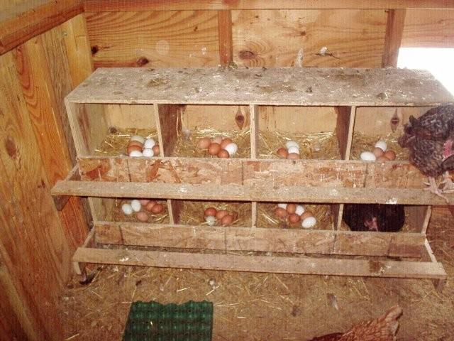
Collisions
No hash function is perfect
Eventually two keys will hash to same number
How do we
know this?
Chicken
Holes

Slide 14
Collisions
Chicken Hole Principle
If you have 8 chickens (each laying 1 egg a day)
and 5 nesting boxes,
you must have a box with at least 2 eggs in it
In general…
For E items being put into B slots,
if E > B then some slot will have 2 or more items
… a collision

Slide 15
Chicken Hole Fun Facts
There are 2 people in Philadelphia with the same number of hairs on their heads
Avg head has 150,000 hairs
Allow 10x avg for variance (hair counts from 1 to 1,500,000)
Philly has 1.55 million heads
Chicken holes B = 1.5million diff hair counts
Eggs E = 1.55 million heads
E > B QED

Slide 16
Chicken Hole Fun Facts
In any group of 367 people, at least 2 of them have the same birthday.
This one is obvious, since the numbers are in the realm of what we normally contemplate or experience
Diff birthdays B = 366 (remember Feb 29)
Eggs E = 367 people
E > B QED

Slide 17
Birthday Paradox/Problem
Just a side note…
In any group of 23 people, there is a 50% chance that 2 have the same birthday
In a group of 75, the probability goes to 99.9% that 2 have the same birthday
Nothing to do with CHP…
it’s just probabilities

Slide 18
Collisions
So # of collisions is affected by
quality of hash function
-- how well it distributes keys over the integers
table structure
-- total number of array slots
-- mathematical properties of the maximum index

Slide 19
Issue 1: Bad Hash Function
Let’s say our hash function is this
take first character of the string
return position of that char in the alphabet (minus 1)
Example:
hash( “ardvaark” ) “a” is position 1, 1-1 = 0
hash( “tarheels” ) “t” is position 20, 20-1 = 19
hash( “data” ) “d” is position 4, 4-1 = 3
hash( “apple” ) “a” is position 1, 1-1 = 0 collision

Slide 20
Bad Hash Function
Why is this bad?
Only 26 different range elements
by CHP can only store 26 keys before collisions
English words themselves… first char is not well distributed over the alphabet
Lots of “s”, “m”, “t” words
Not many “x”, “z”, “q” words
We will use it anyway, later, for ease of illustration

Slide 21
Better Hash Function
Other ideas…
Use middle char, better distributed than first
Or use several chars (or all of them) and build an integer arithmetically
function hash (key, tabSize) {
hval = 0;
for (var i=0; i<key.length(); i++) {
hval += key.charAt(i);
}
return hval % tabSize;
}
If tabSize is large (say 10007)
keys short (say 8-15 chars)
then the sum of the chars is small
and will cluster at low end of table

Slide 22
Better Hash Function
Other ideas…
Maybe add up chars several times (based on tabSize)
Adjust final integer to tabSize
function hash (key, tabSize) {
hval = 0;
nt = tabSize/key.length();
for (var i=0; i<key.length(); i++) {
hval += key.charAt(i);
}
return (nt*hval) % tabSize;
}
Now low slots might be underused
if keys are short (say 1-5 chars)
then sum of the chars is small
and is multiplied into middle of the table.

Slide 23
Pretty Good Hash Function
Other ideas…
Spin through string using prime mults to prevent cycles
function hash (key, tabSize) {
hval = 7;
for (var i=0; i<key.length(); i++) {
hval = (hval*31) + key.charAt(i);
}
hval % tabSize;
if (hval<0) { hval += tabSize; }
return hval;
}
Do in 32-bit integer arithmetic, make use of overflow
Java hashCode( ) does similar to this

Slide 24
Issue 2: Table Size
Best to pick table size that is prime
Load factor l
defined as ratio of #elts in table
---------------
table size
for example if we have
5003 elements stored (so far)
in a table with size 10007
then l is ( 5003 / 10007 )
l is approx. 0.5
table is about half-full ?
depends on how collisions are handled

Slide 25
Issue 3: Collision Resolution
Two main forms of handling collisions
Hash into lists (buckets, chaining)
each array slot contains not a single element, but rather a list
Linear probing
each array slot contains one element
hash to a full slot, there is a plan for going on to some “next” slot to try
How will this affect O(1) on insert, find ?

Slide 26
Hash to Lists
Table entry is a null, or a list of cells
Each cell contains a data object
key and associated data
If a new key hashes to an empty slot, then start a new list with that key data
If a new key hashes to an occupied slot, then add that key data to the list

Slide 27
Example
0
andy
1
Keys: hash
andy,
dennis,
zorba,
claire,
wanda,
charles,
fern,
warren,
cindi,
xerxes,
donna
2
claire
charles
cindi
0
3
dennis
donna
3
25
4
2
22
5
fern
2
5
22
2
22
wanda
warren
23
23
xerxes
3
24
Let’s use that bad hash function
(char pos in alphabet), for ease of illustration …
25
zorba

Slide 28
Difference?
0
andy
X
1
X
Keys:
andy,
dennis,
zorba,
claire,
wanda,
charles,
fern,
warren,
cindi,
xerxes,
donna
2
cindi
charles
claire
X
3
donna
dennis
X
4
X
5
fern
X
22
warren
wanda
X
23
xerxes
X
24
X
Add at head of list
25
zorba
X

Slide 29
Complexity w/Lists
Is a BST worth it (instead of LIST) ?
find is O(1) hash + O( ½ LIST length)
insert is O(1) hash + O(1) add to head of LIST
If list length is short, O( ½ LIST length ) is about O(1)
BST is over complicated for little gain, if any
Better to concentrate on how to keep lists short
Make table size bigger,
make hash function distribute over more slots

Slide 30
Linear Probing
Table entry is null, or a single cell
Each cell contains a data object
key and associated data
If a new key hashes to an empty slot, then store a cell there with that key data
If a new key hashes to an occupied slot, then compute a next slot to try (repeat as needed)

Slide 31
Linear Probing
On collision, we try other slots “near by”
This is a systematic, repeatable procedure
Linear probing says (informally)
If table[ hash(key) ] is full, then try next slot
table[ hash(key)+1 ] … if full try next slot
table[ hash(key)+2 ] … etc.
until one is open

Slide 32
Example
andy
0
1
Keys: hash
andy,
dennis,
zorba,
claire,
wanda,
charles,
fern,
warren,
cindi,
xerxes,
donna
2
claire
Shows “clustering” or “clumping”
where you get heavily used crowded parts,
empty parts…
0
3
dennis
3
4
charles
25
5
fern
2
6
cindi
22
7
donna
2 → 3 → 4
8
5
22 → 23
2 → 3 → 4 → 5 → 6
23 → 24
22
wanda
3 → 4 → 5 → 6 → 7
23
warren
24
xerxes
25
zorba

Slide 33
Clustering Issues
Clustering slows access
It’s like having to search a list in hashing to lists
Solution: larger table size
Table space in probing is like the list cells in chaining
More space means more open slots for initial hash, less hopping to probe
Load λ should be ½ for probing (assumes well distributed hash function)

Slide 34
Clustering Issues
Solution: need a custom hash function?
Some data may have a form that makes clusters with some hash funcs, not with others
Consider:
McDuff, MacBeth, McBride, McDaniel, MacGraw, MacDonald,
MacLean, McKensie, McDermott, …
If the hash uses, say, first 3 chars, then they all are going to 2 or 3 cells
For any hash fn, we can make data to cause such clusters
No hash func is perfect,
or even good for ALL data sets

Slide 35
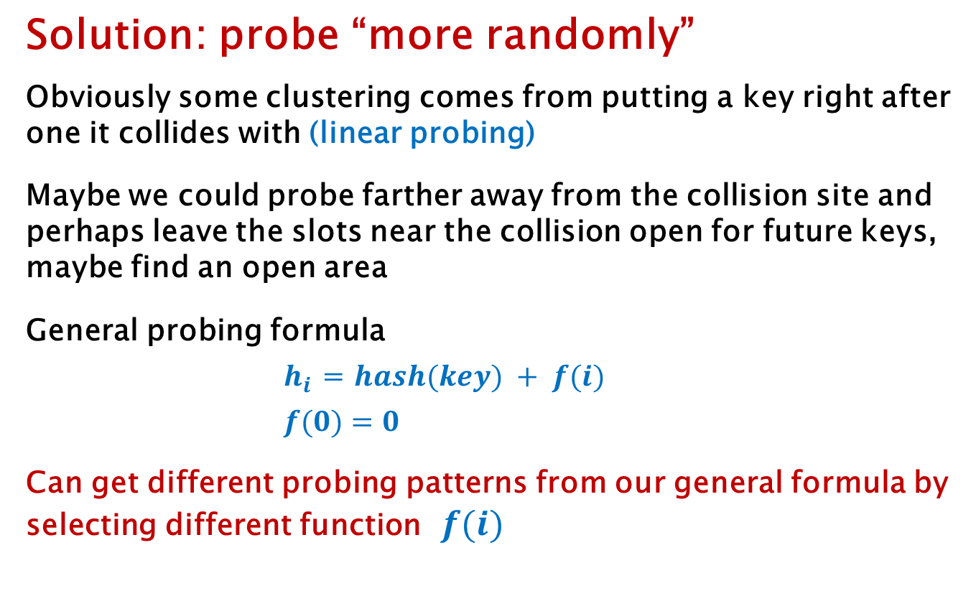
Clustering Issues
Solution: probe “more randomly”
Obviously some clustering comes from putting a key right after one it collides with (linear probing)
Maybe we could probe farther away from the collision site and perhaps leave the slots near the collision open for future keys, maybe find an open area
General probing formula
$h_{i}$ = $hash(key) + f(i)$
$f(0)=0$
Can get different probing patterns from our general formula by selecting different function $f(i)$

Slide 36
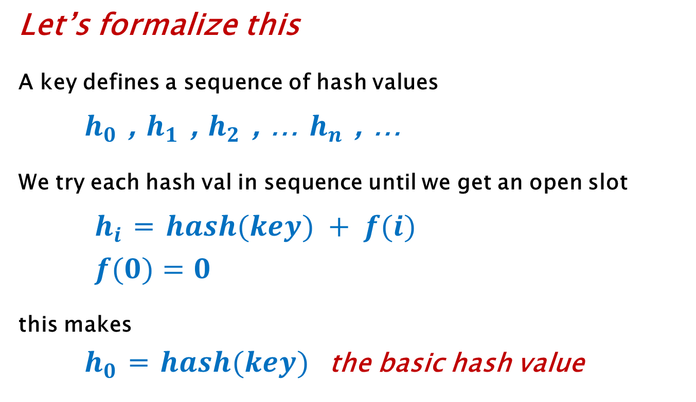
General Probing
Let’s formalize this
A key defines a sequence of hash values
$h_{0}$ , $h_{1}$ , $h_{2}$ , … $h_{n}$ , …
We try each hash val in sequence until we get an open slot
$h_{i}$ = $hash(key) + f(i)$
$f(0)=0$
this makes
$h_{0}$ = $hash(key)$the basic hash value

Slide 37
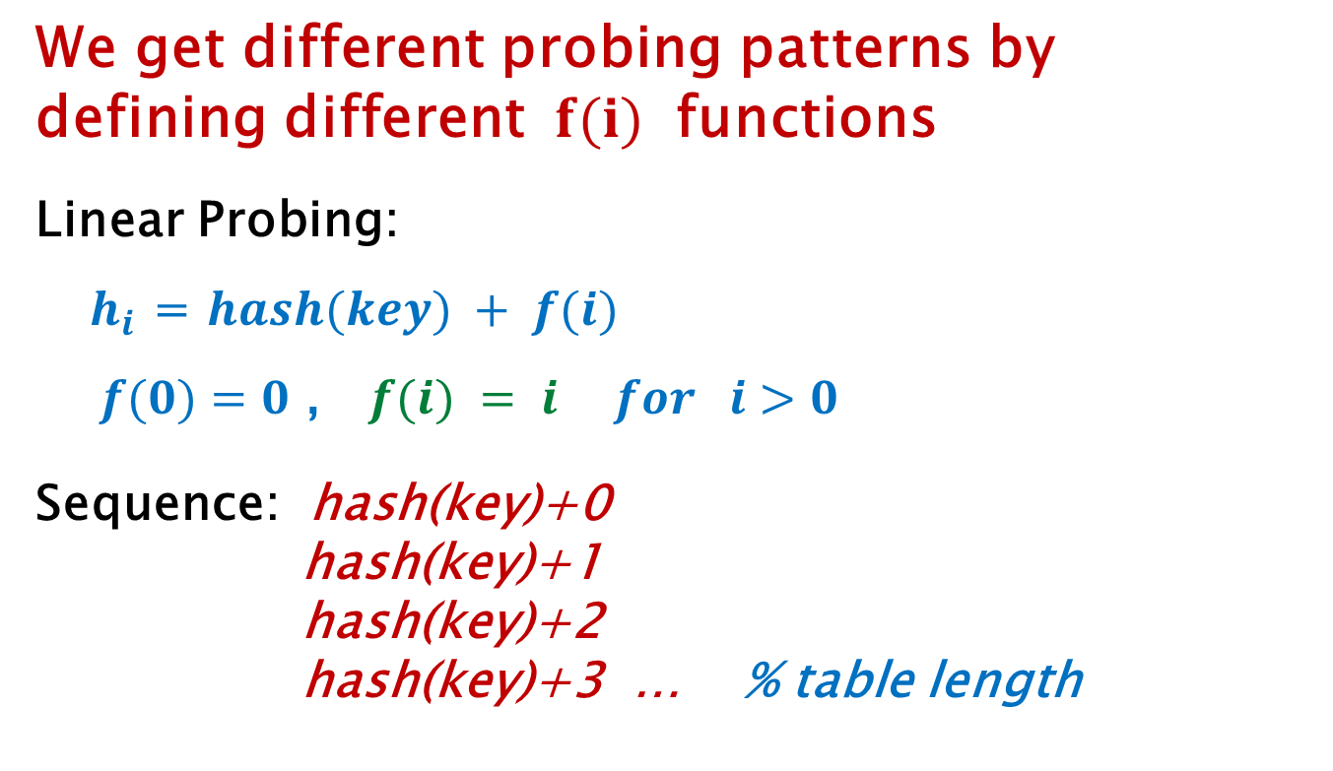
Linear Probing
We get different probing patterns by
defining different $f(i)$ functions
Linear Probing:
$h_{i}$ = $hash(key) + f(i)$
$f(0)=0$ , $f(i) = i for i>0$
Sequence: hash(key)+0
hash(key)+1
hash(key)+2
hash(key)+3 … % table length

Slide 38
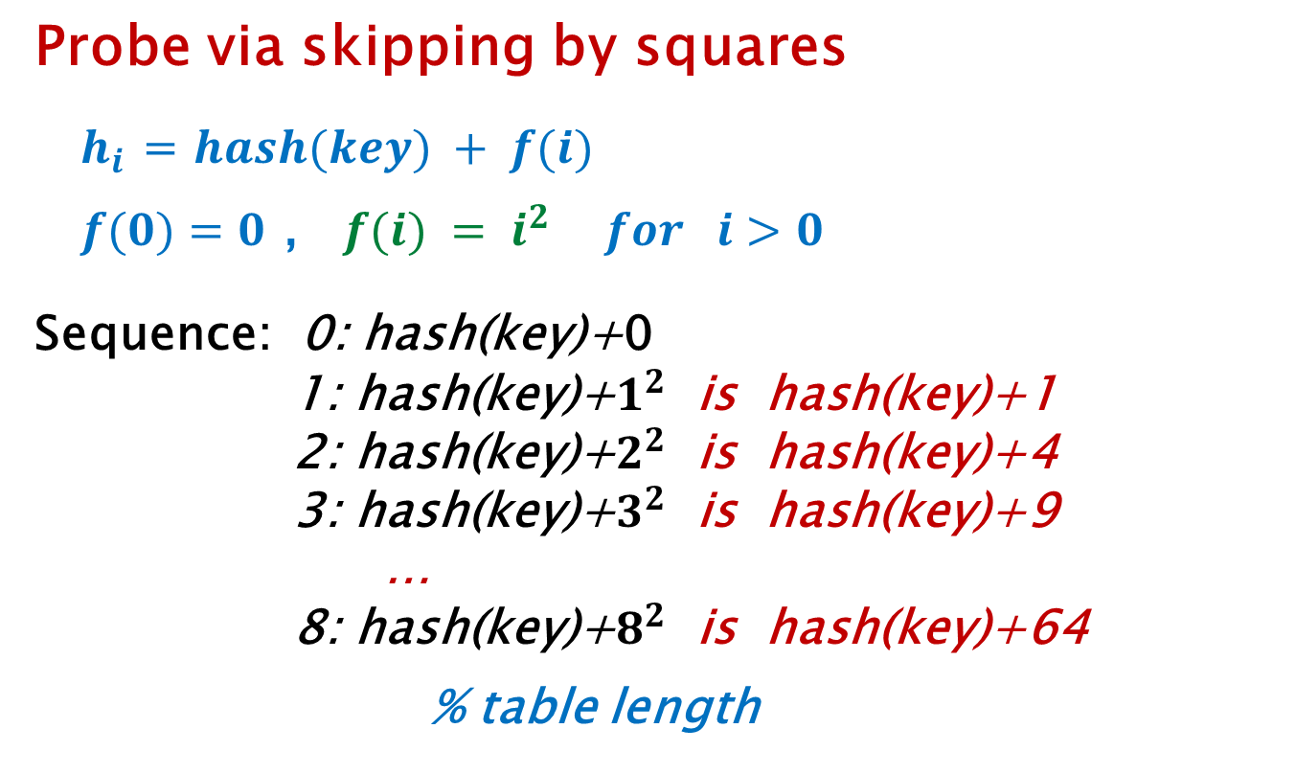
Quadratic Probing
Probe via skipping by squares
$h_{i}$ = $hash(key) + f(i)$
$f(0)=0$ , $f(i) = i^{2} for i>0$
Sequence: 0: hash(key)+0
1: hash(key)+$1^{2}$ is hash(key)+1
2: hash(key)+$2^{2}$ is hash(key)+4
3: hash(key)+$3^{2}$ is hash(key)+9
…
8: hash(key)+$8^{2}$ is hash(key)+64
% table length

Slide 39
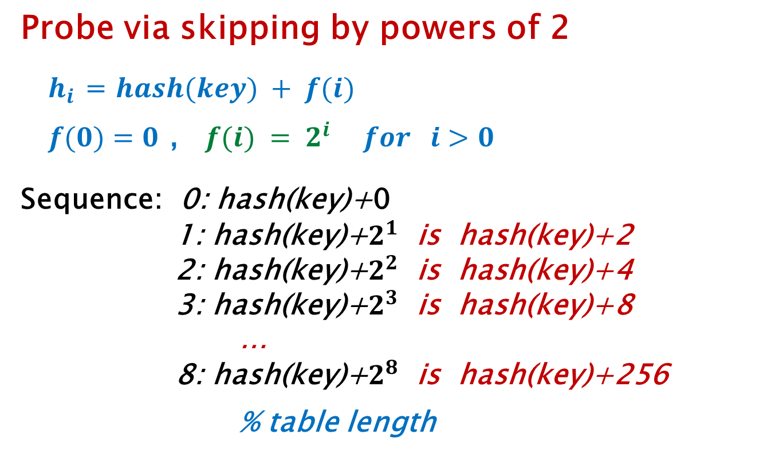
Exponential Probing
Probe via skipping by powers of 2
$h_{i}$ = $hash(key) + f(i)$
$f(0)=0$ , $f(i) = 2^{i} for i>0$
Sequence: 0: hash(key)+0
1: hash(key)+$2^{1}$ is hash(key)+2
2: hash(key)+$2^{2}$ is hash(key)+4
3: hash(key)+$2^{3}$ is hash(key)+8
…
8: hash(key)+$2^{8}$ is hash(key)+256
% table length

Slide 40

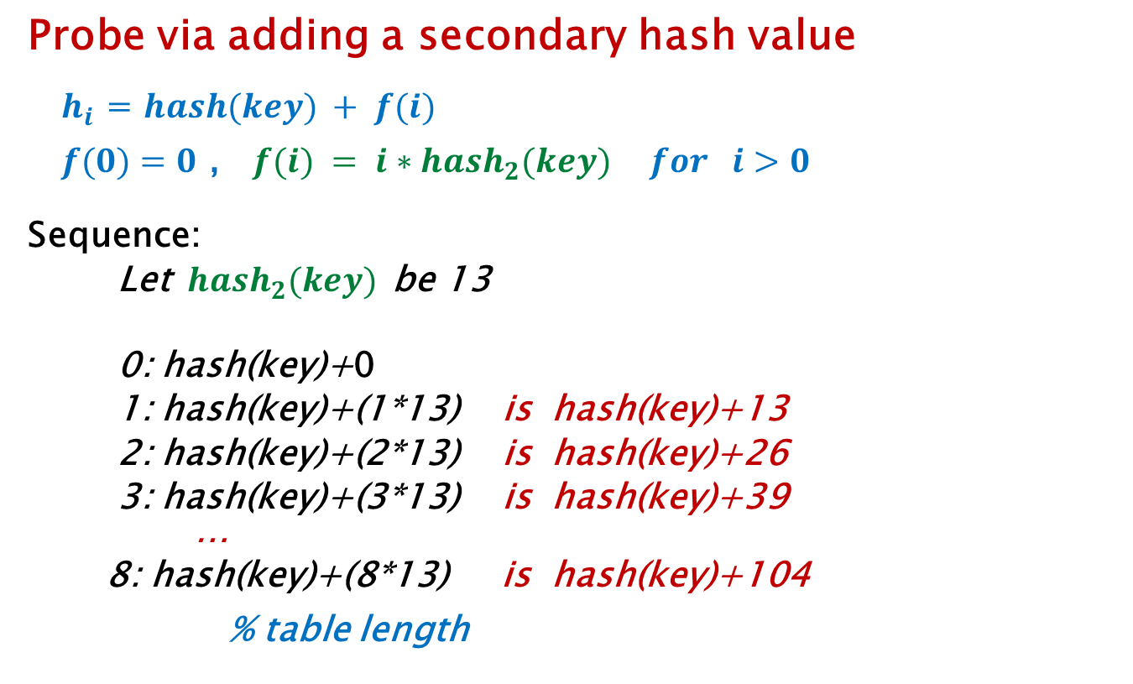
Double Hashing
Probe via adding a secondary hash value
$h_{i}$ = $hash(key) + f(i)$
$f(0)=0$ , $f(i) = {i∗hash}_{2}(key) for i>0$
Sequence:
Let ${ hash}_{2}(key)$be 13
0: hash(key)+0
1: hash(key)+(1*13) is hash(key)+13
2: hash(key)+(2*13) is hash(key)+26
3: hash(key)+(3*13) is hash(key)+39
…
8: hash(key)+(8*13) is hash(key)+104
% table length
${hash}_{2}(key)$
can’t ever be 0

Slide 41
Load λ
Optimal table loading varies
We assume a well-distributing hash function
Recall load λ is ( #elts stored / #slots in table )
Load λ should be ½ for probing
Load λ should be 1 for chaining
Java uses chaining implementation for HashMap
Java selects λ of 0.75 by default (you can override)

Slide 42
Load λ
Load λ should be ½ ? Means what?
Normally means “no more than”
Table loading is dynamic, λ changes as we add elements
Consider table size 100 … empty…
load is 0/100 = 0
We add first element…
load is 1/100 = 0.01
We add 50 more elements… load is 51/100 = 0.51
Now what?

Slide 43
Load Limits
Load λ goes over the limit…
now what?
We can continue to load the table
With chaining the table never really runs out of space…
Even if table has a list in every array slot,
We can always extend the lists
Cons
suffer slowing of access operations, O( ½ LIST length)
won’t work for probing, as the table *will* really fill

Slide 44
Resize and Rehash
Load λ goes over the limit… now what?
We can extend the array (table) size
Resize:
Allocate a new larger array
double it is a good plan, to a prime beyond
Rehash:
For each item in the old table, hash it into the new table
O(N) operation for N keys in the table
Must rehash since hash function is based on table size
Rehashing will shorten the chains, space out keys
Load λ is cut in half this way (doubling table size)
Java HashMap does this automatically

Slide 45
Remove
We have discussed insert, find …
What about remove ?
Chaining
remove is easy, it’s just removing from a list
O(1) to hash key
O( ½ LIST length ) to find item
O(1) to unlink it

Slide 46
Remove
We have discussed insert, find …
What about remove ?
Probing
remove is not simple
can’t just hash/probe to find, then empty the table cell
might well cause a gap in some probe chain
“lazy” deletion is required
can replace the removed key with some “inactive” marker
on search, “inactive” says “occupied, keep probing”
on insert, “inactive” says “open, free for use”

Slide 47
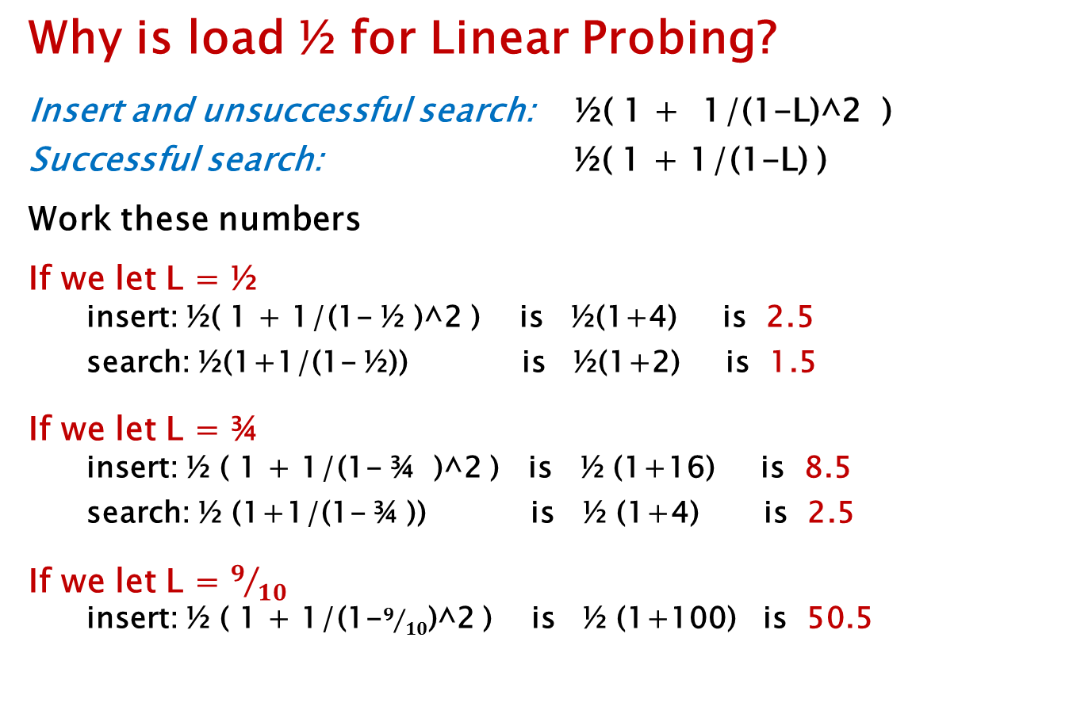
Analysis
Why is load ½ for Linear Probing?
Insert and unsuccessful search: ½( 1 + 1/(1-L)^2 )
Successful search: ½( 1 + 1/(1-L) )
Work these numbers
If we let L = ½
insert: ½( 1 + 1/(1- ½ )^2 ) is ½(1+4) is 2.5
search: ½(1+1/(1- ½)) is ½(1+2) is 1.5
If we let L = ¾
insert: ½ ( 1 + 1/(1- ¾ )^2 ) is ½ (1+16) is 8.5
search: ½ (1+1/(1- ¾ )) is ½ (1+4) is 2.5
If we let L = $9/{10}$
insert: ½ ( 1 + 1/(1-$9/{10}$)^2 ) is ½ (1+100) is 50.5

Slide 48
END
Ignore anything past this

